Slide 1

Validated Automatic Brain Extraction of Head CT Images
John Muschelli (@StrictlyStat)

Slide 2
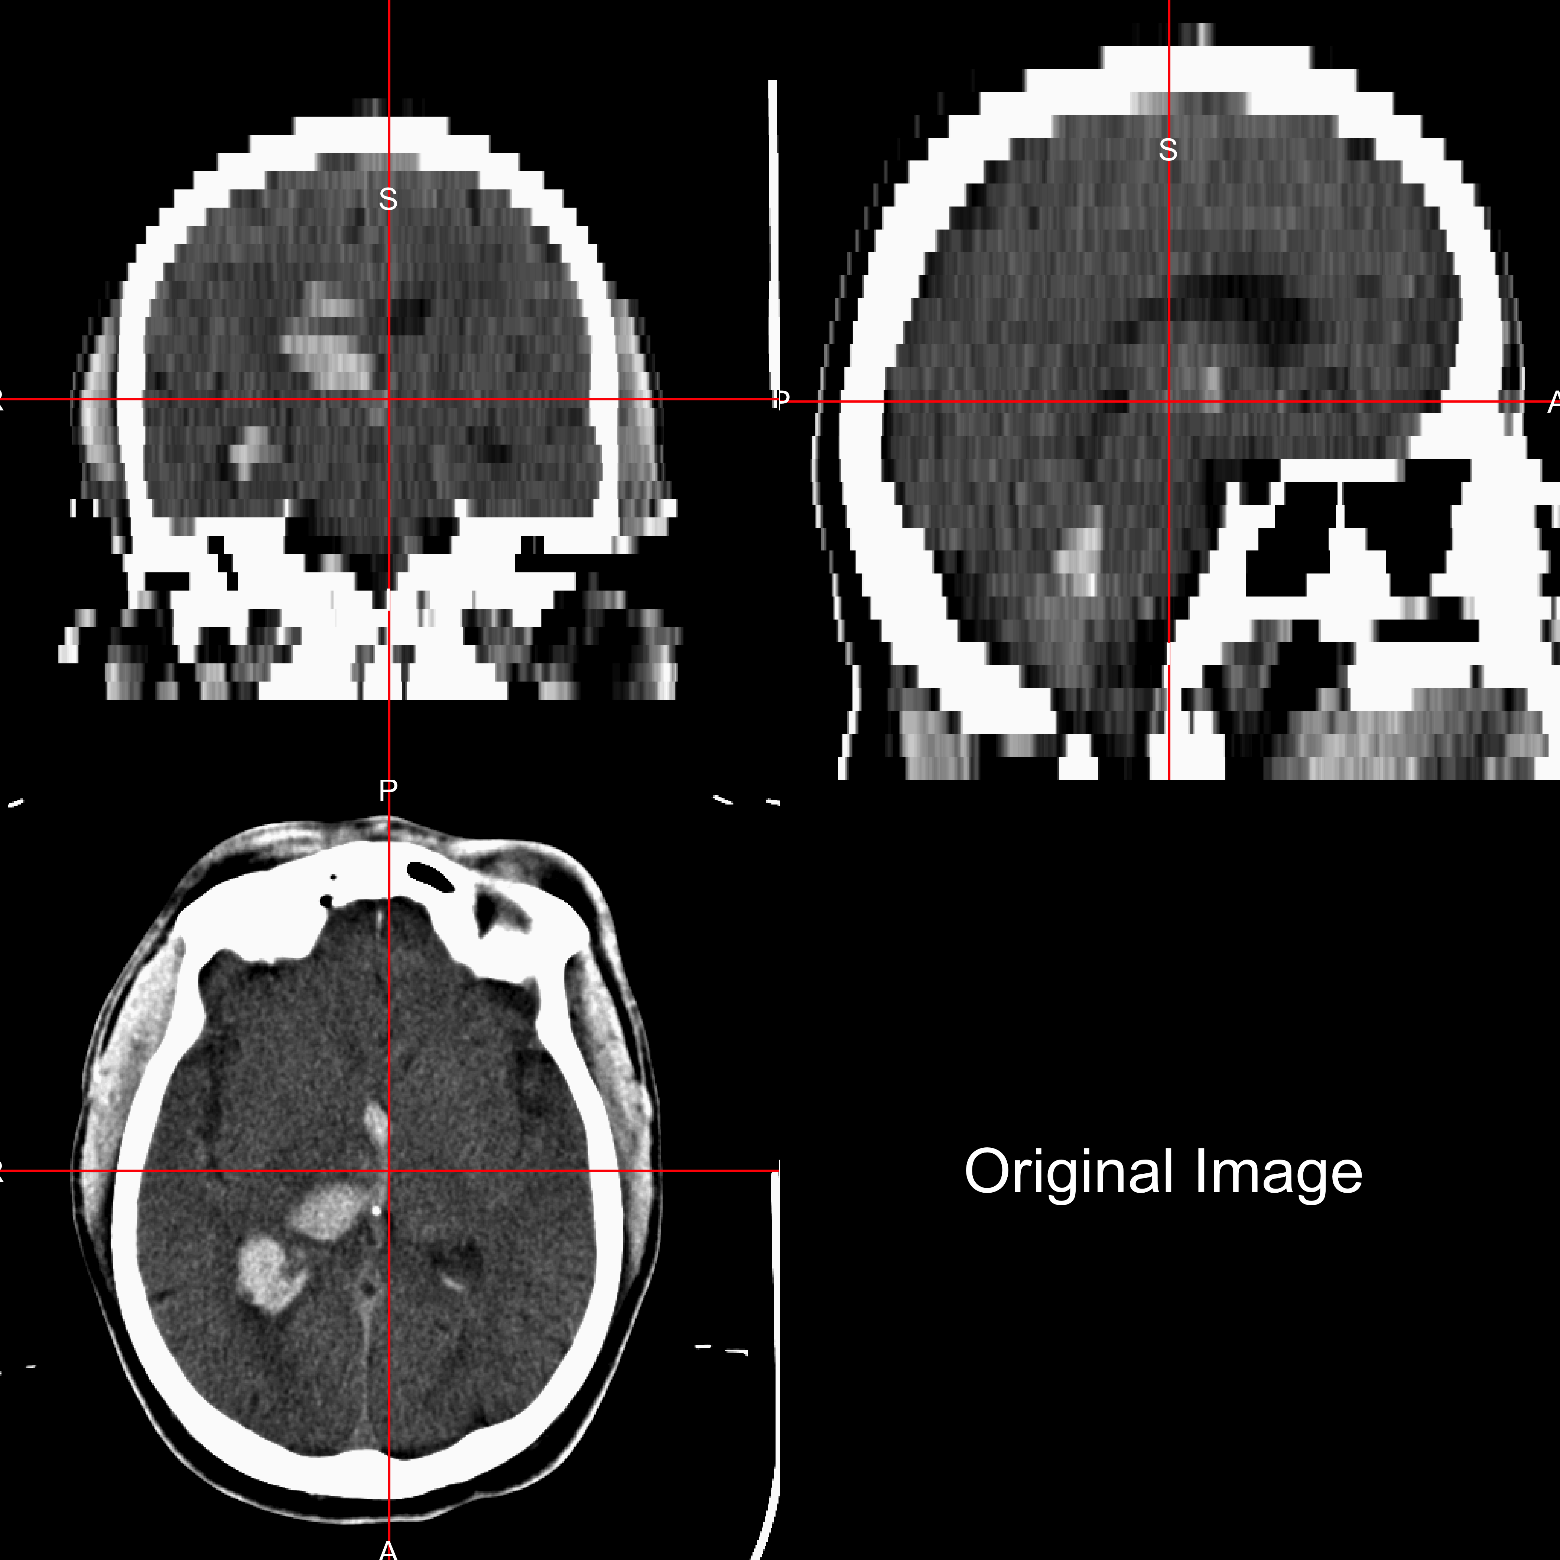
CT Image (it’s NOT an MRI)
Hounsfield Units (HU) are “standardized”, unlike MRI
Bone – high intensity (1000)
Air – low intensity (-1000)
Water - 0
All “objects” captured
Data from MISTIE and CLEAR stroke trials
Notes:
Note the bed, the face and the nasal cavities. This is a patient with a intracranial hemorrhage

Slide 3
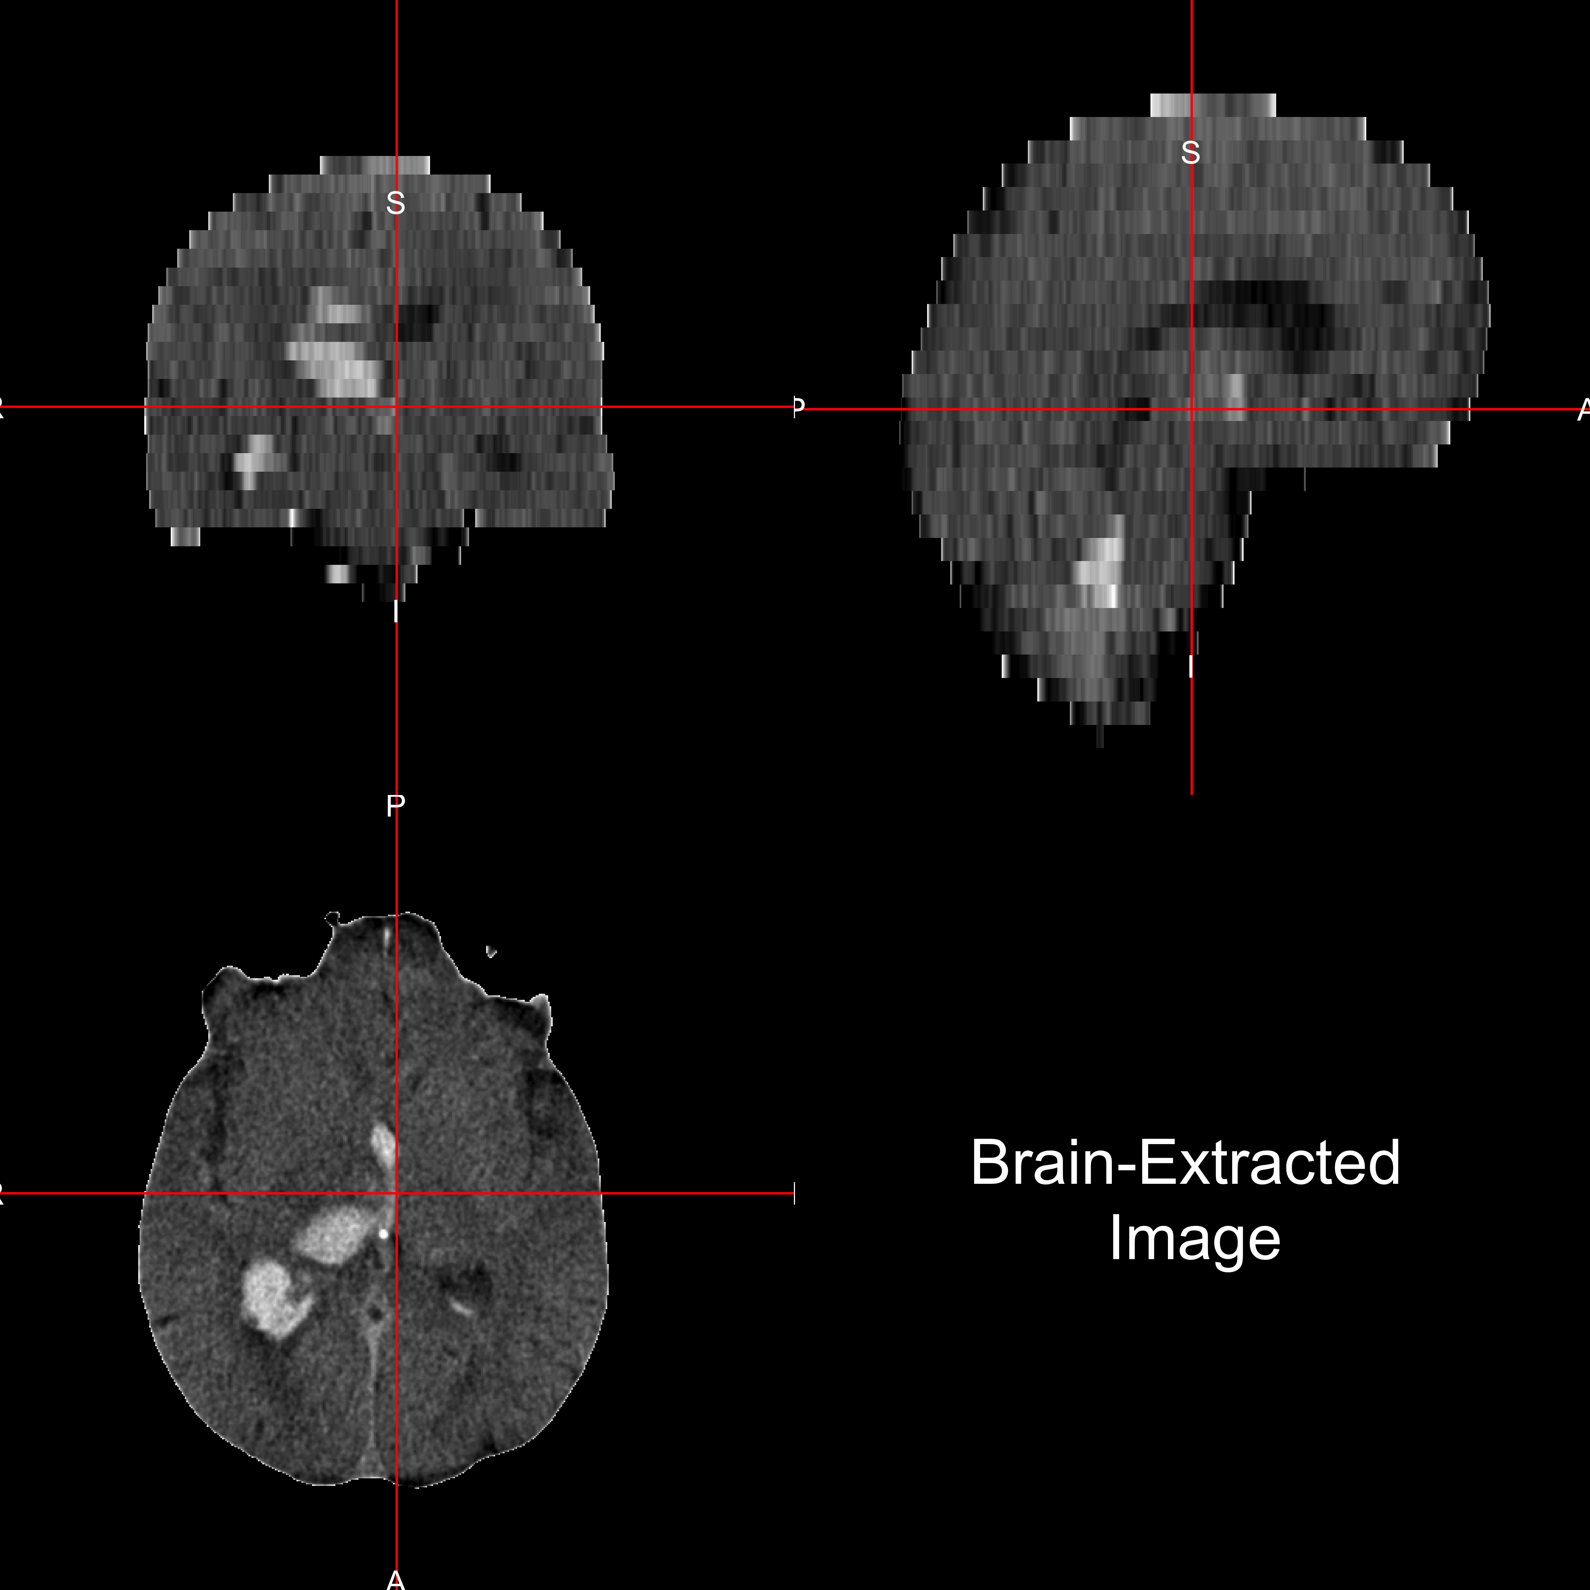
Goal Go from this to this
Notes:
Using Standardized software – not re-inventing the wheel

Slide 4
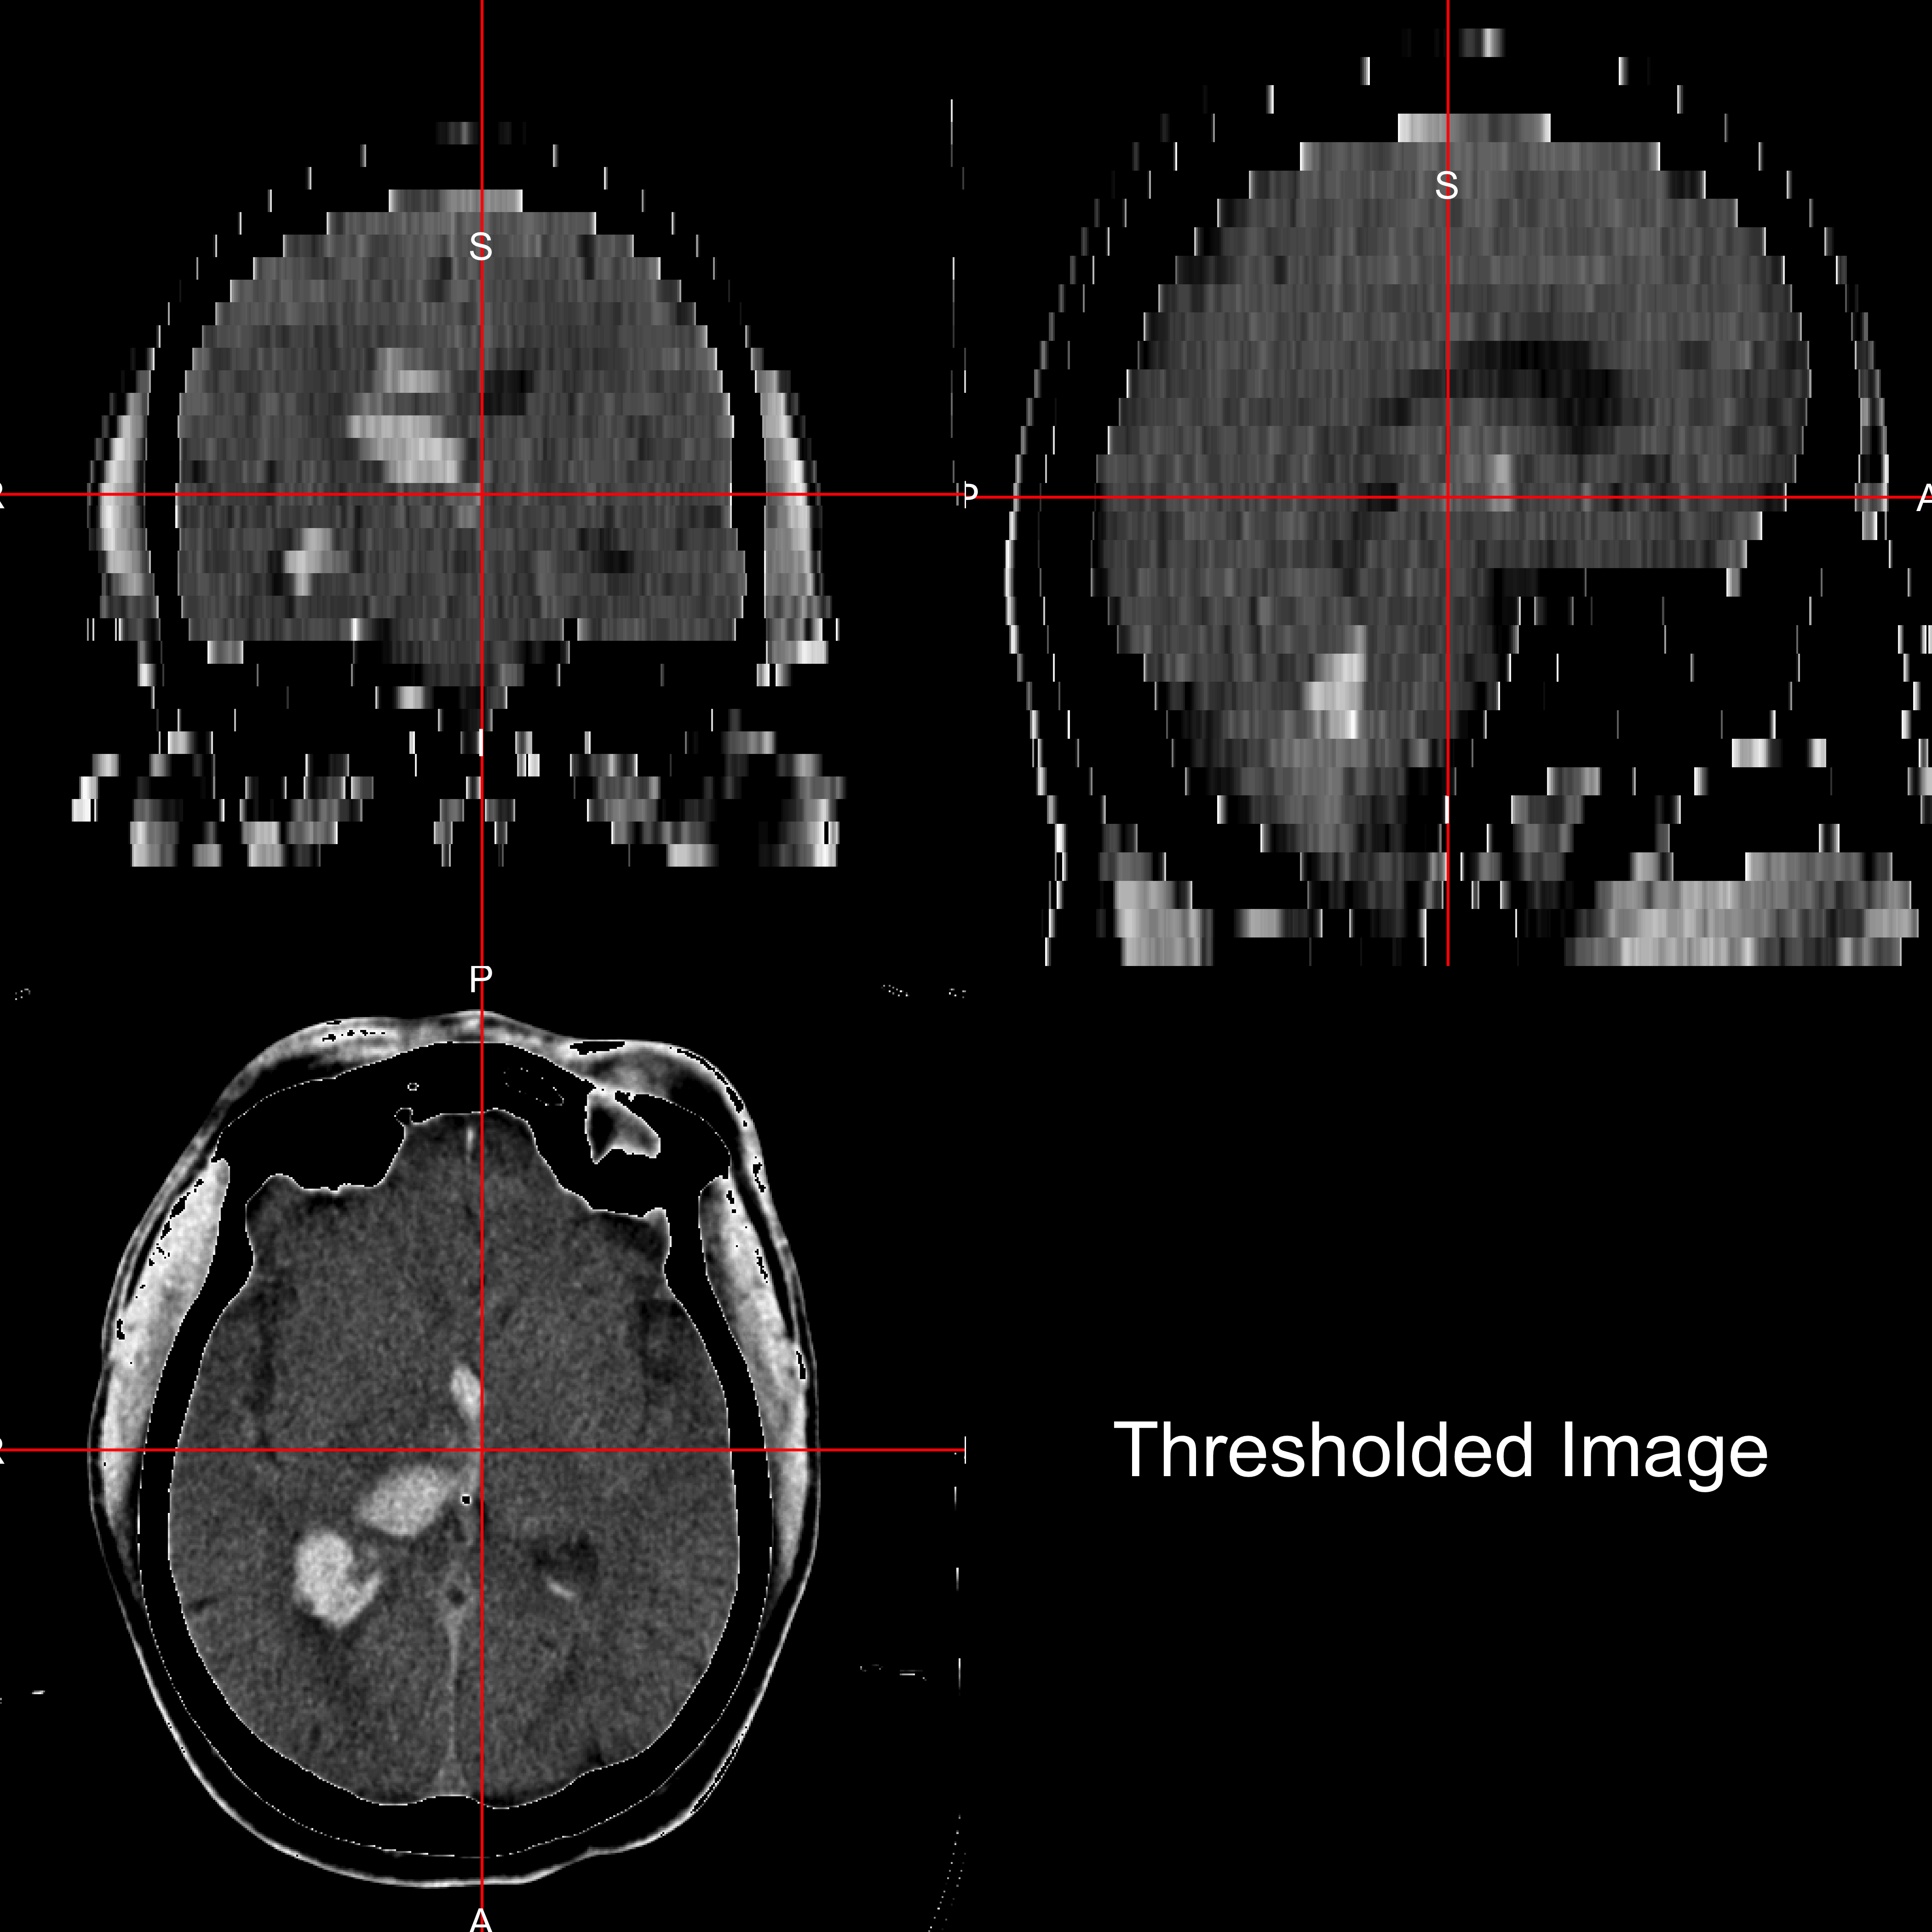
How? Threshold image (0-100 HU)

Slide 5
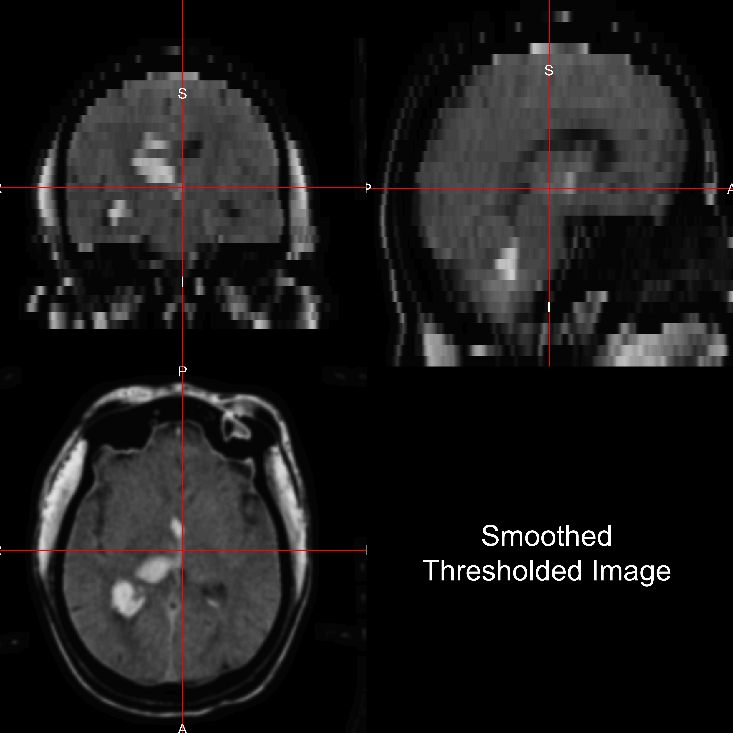
Smooth image (1mm 3D Gaussian kernel)

Slide 6
Run BET (Brain Extraction Tool) from FSL

Slide 7
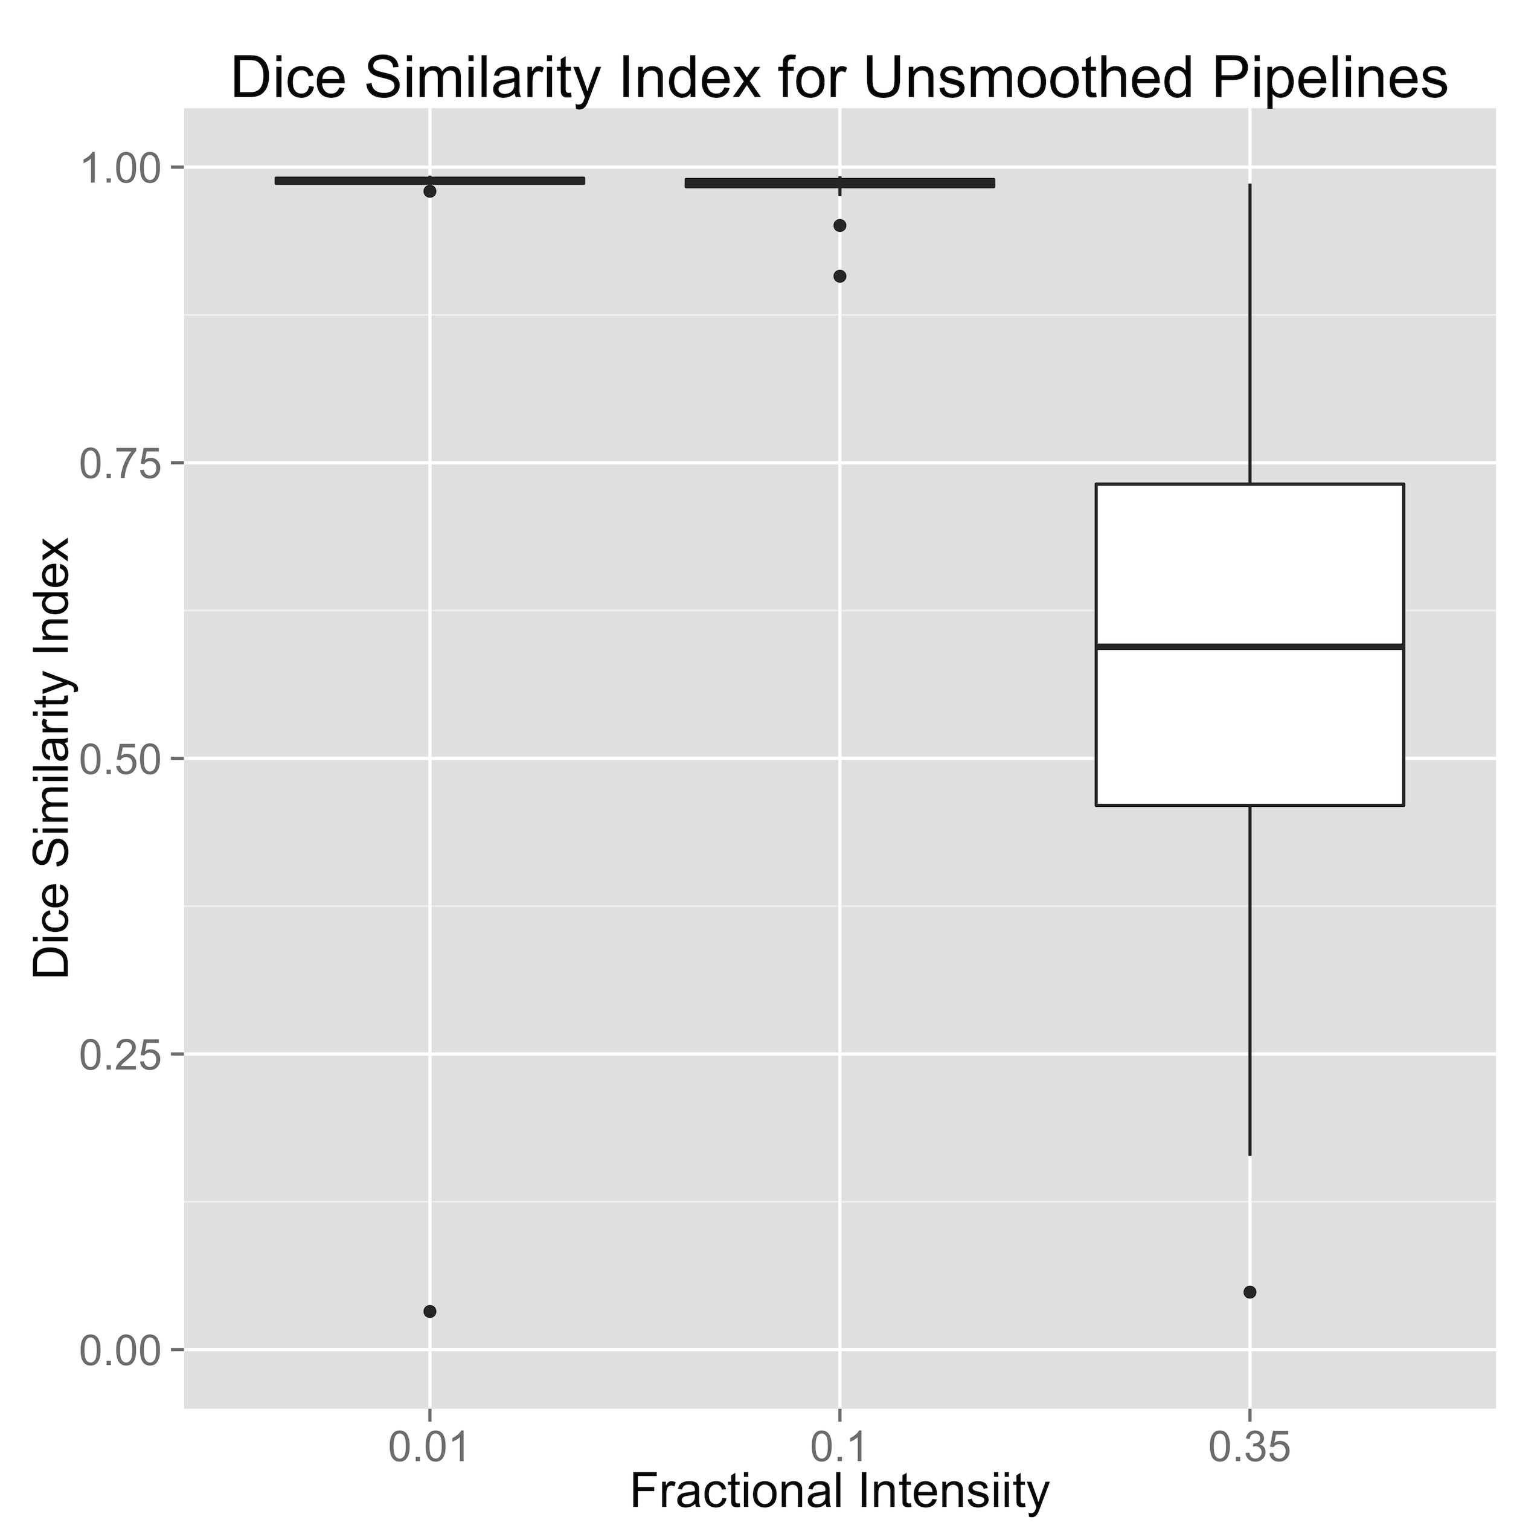
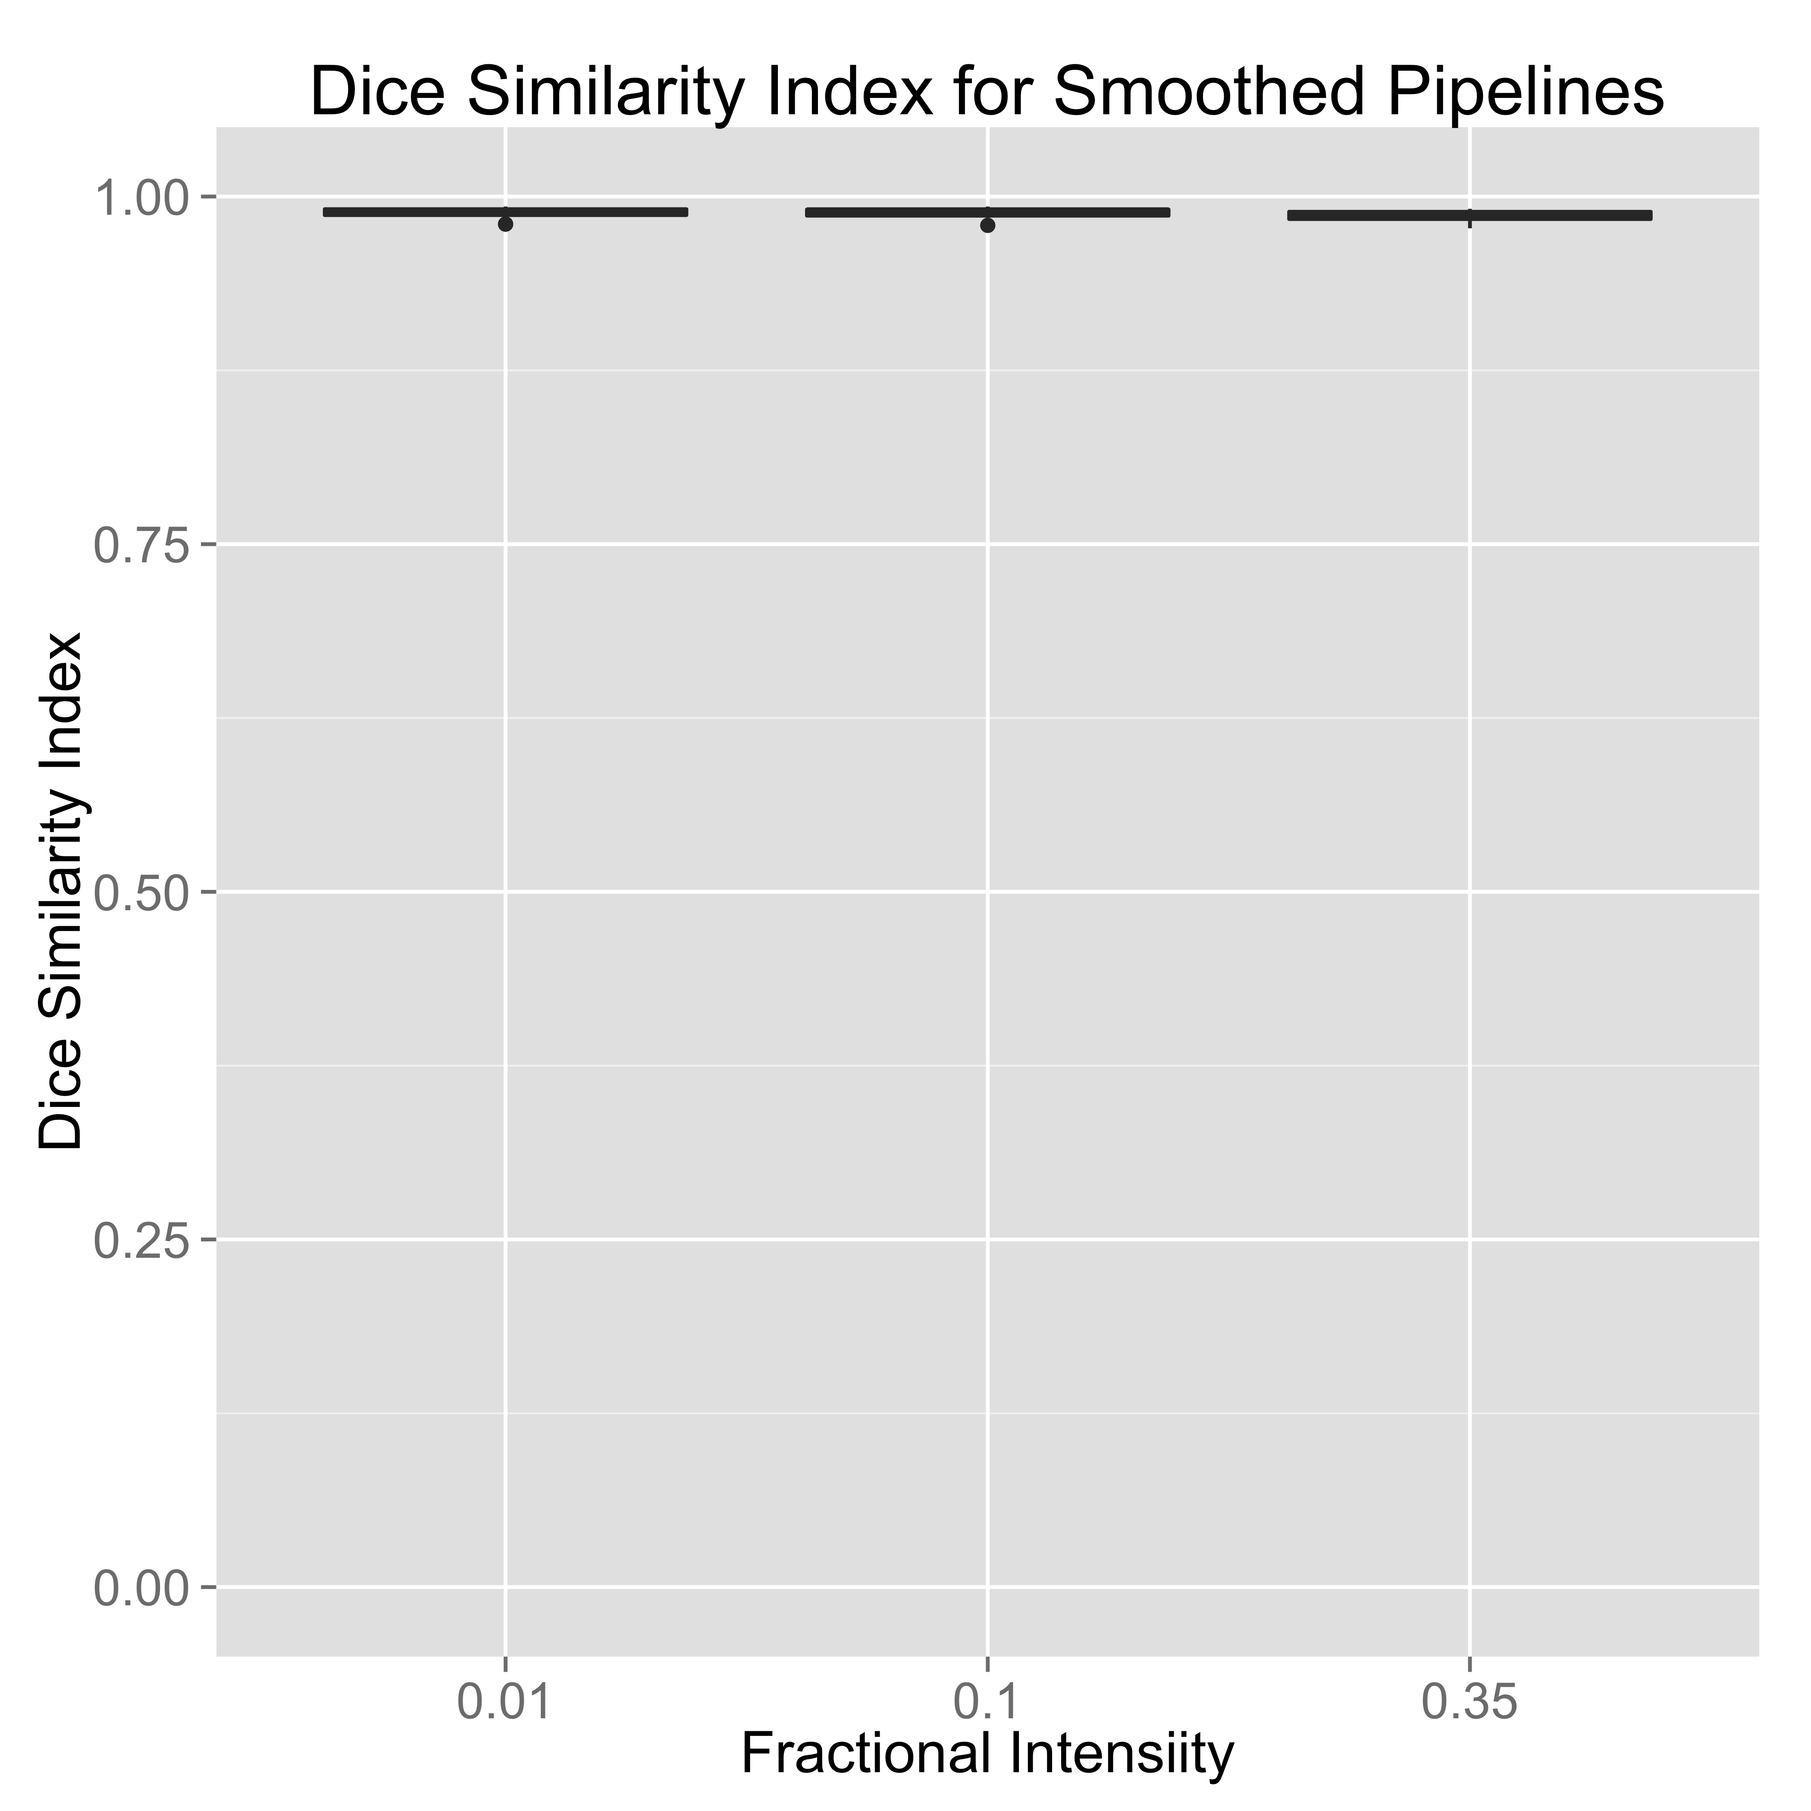
Validation: Compare to gold standard: 22 images from 19 patients

Slide 8
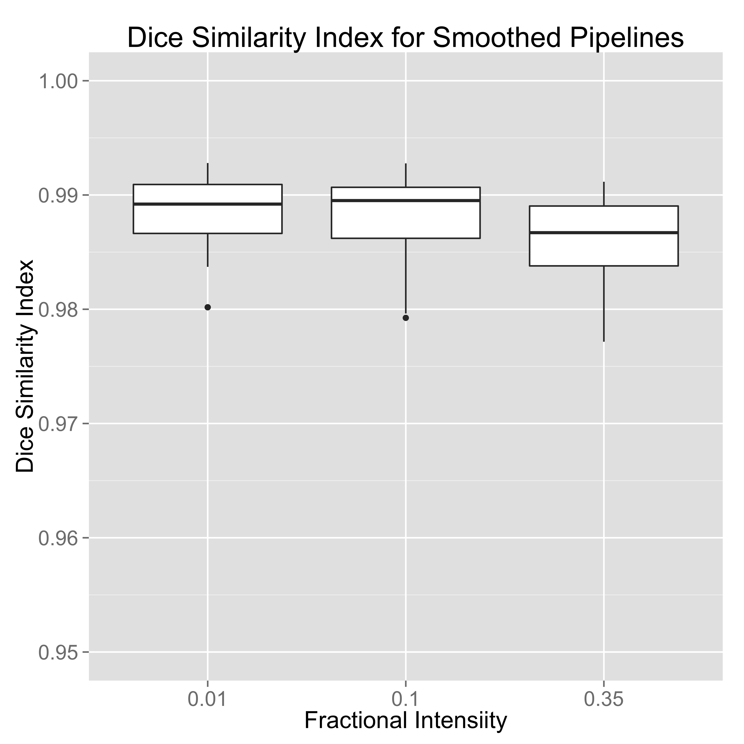
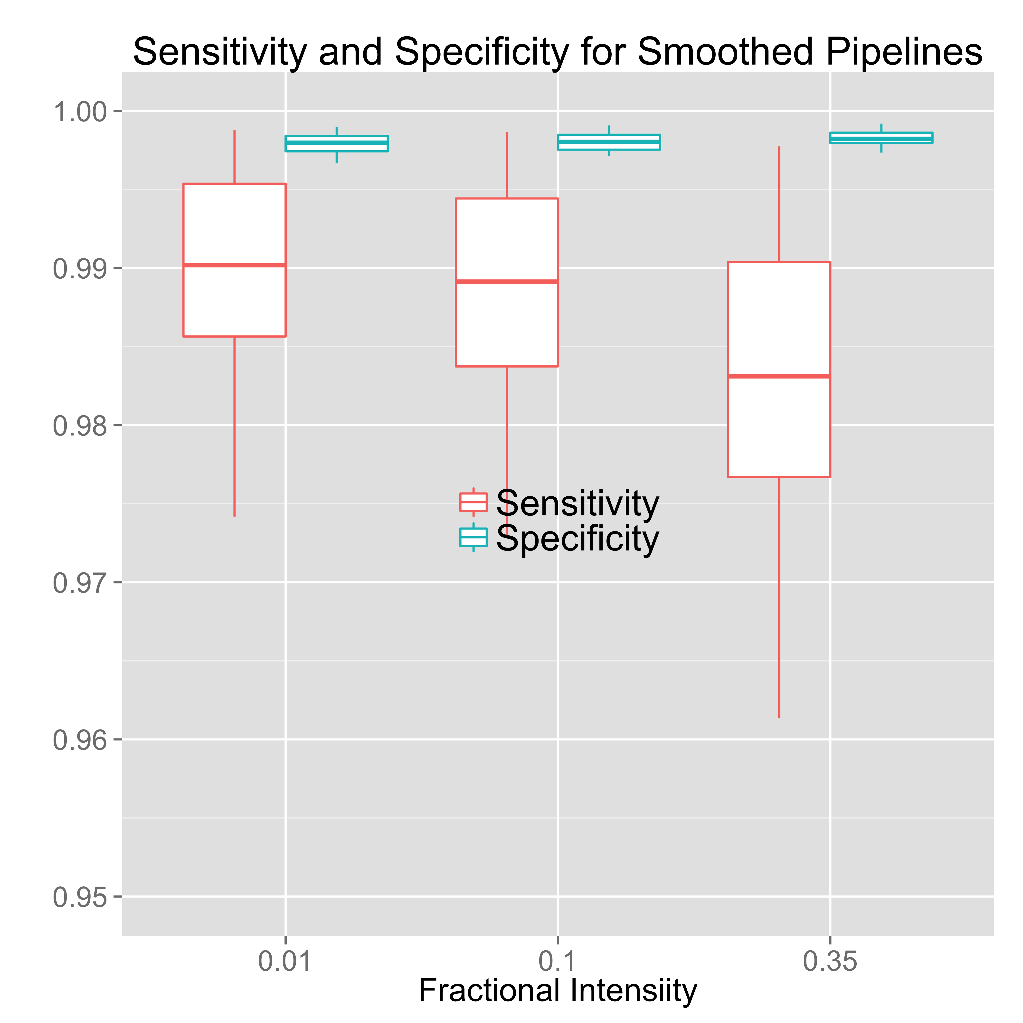
Validation: Only Smoothed Images (Note change of scale)

Slide 9
Intraclass Correlation Estimate
1062 images from 133 patients, excluding 115 scans for craniotomy or skull stripping failure (9.8%).

Slide 10
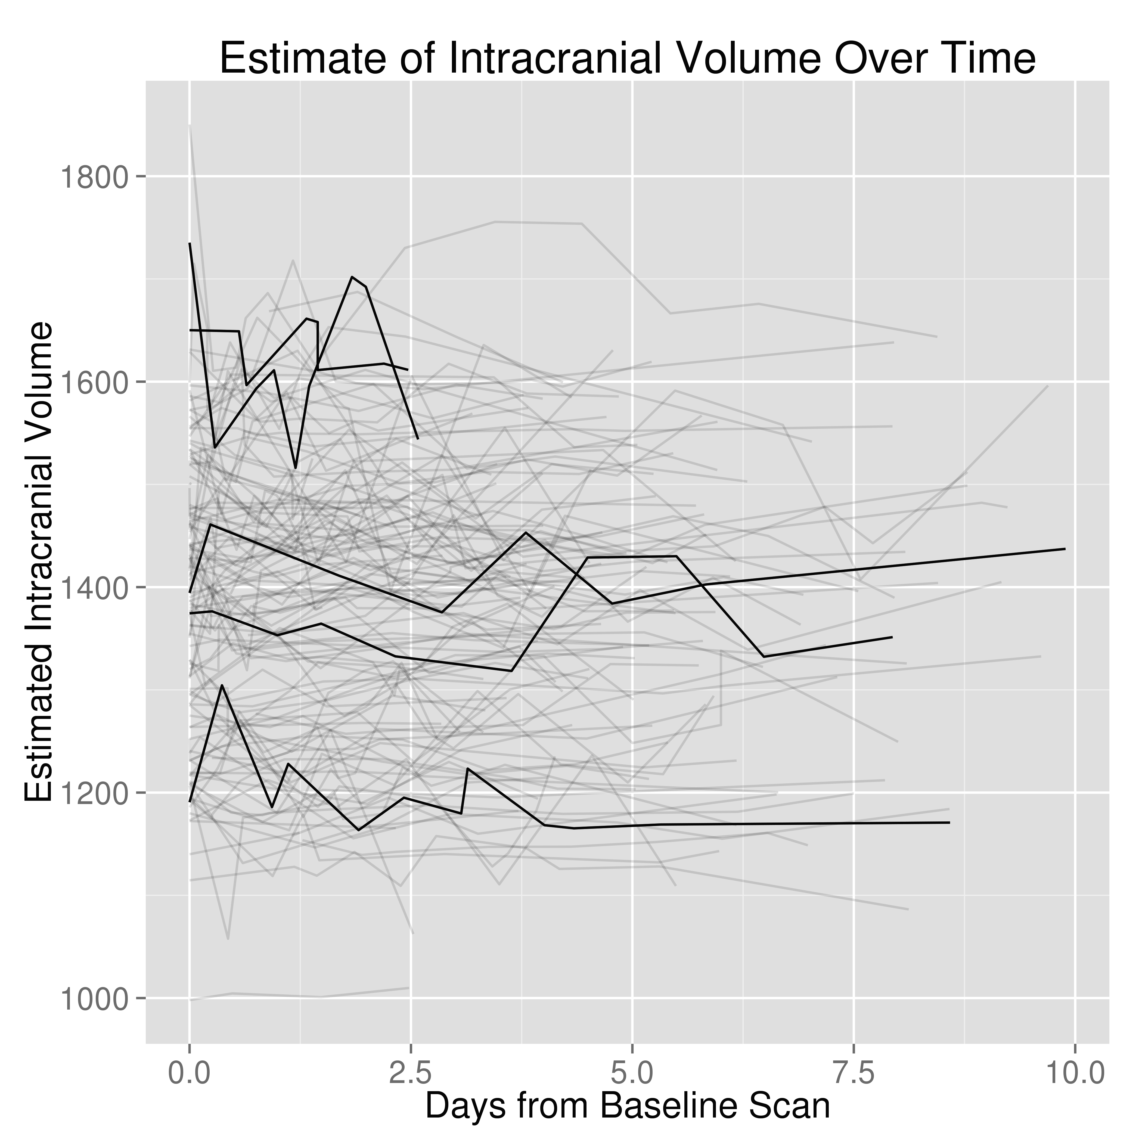
Up to Day 10

Slide 11
Intraclass Correlation Estimate
1062 images from 133 patients, excluding 115 scans for craniotomy or skull stripping failure (9.8%).
Intraclass correlation estimate: 0.93, (95%CI : 0.91, 0.95).

Slide 12
Conclusion
BET works with CT, after some processing (namely smoothing)
R code: http://bit.ly/CTBET_RCODE
bash code: http://bit.ly/CTBET_BASH

Slide 13

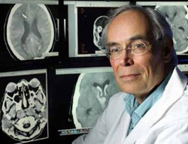

Thanks!
Joint work with:
Ciprian Crainiceanu
Daniel Hanley
Natalie Ullman

Slide 14
Where does this method fail?
Notes:
Overlaid in red is the estimated brain mask

Slide 15
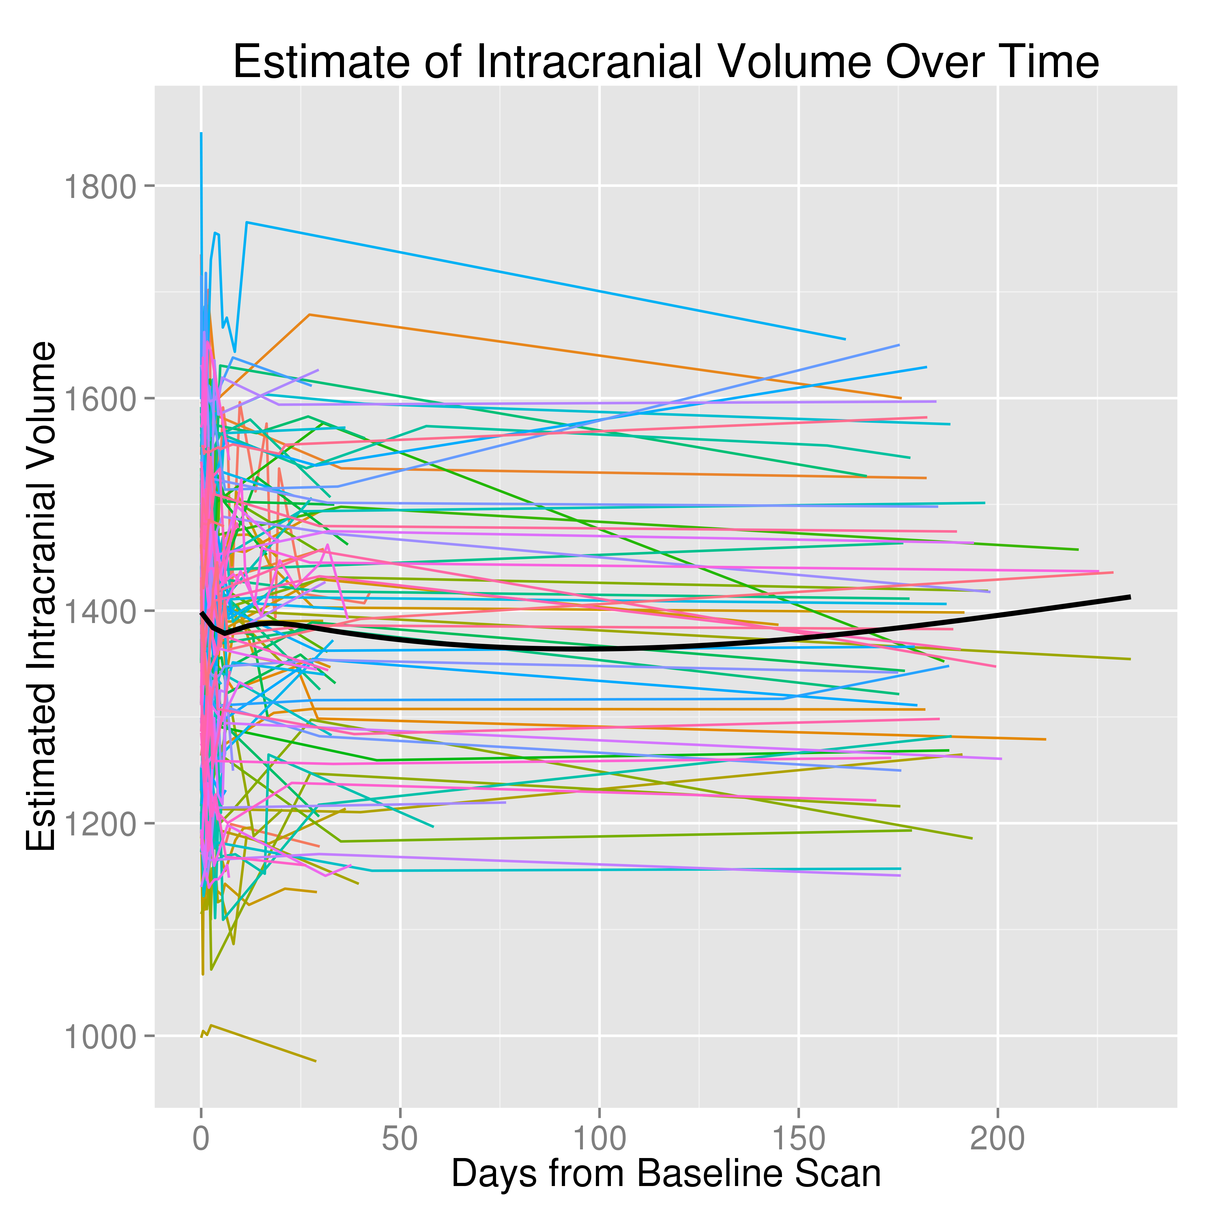
All Data

Slide 16
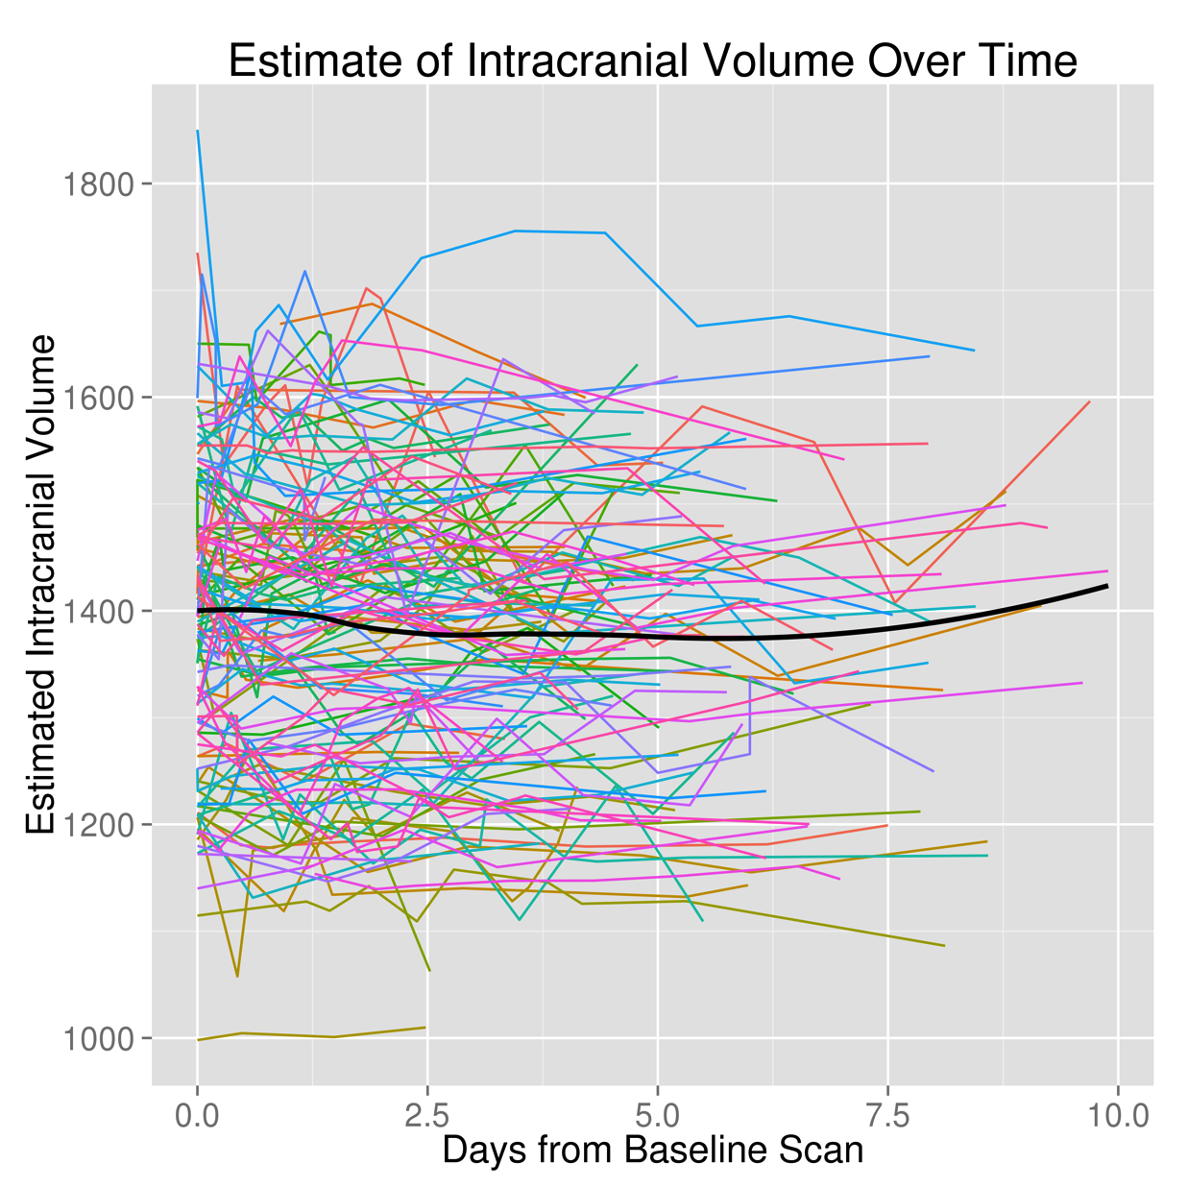
Up to Day 10

